Slide 1
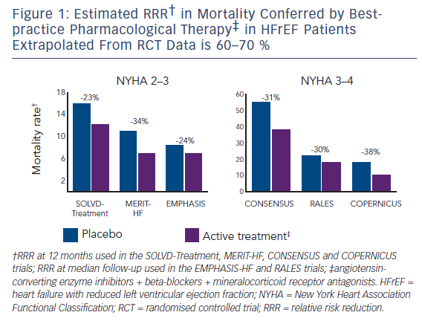
Hayman S, Atherton JJ
Figure 1: Estimated RRR† in Mortality Conferred by Bestpractice Pharmacological Therapy‡ in HFrEF Patients Extrapolated From RCT Data is 60–70 %
Citation: Cardiac Failure Review 2016;2(1):47–50
https://doi.org/10.15420/cfr.2016:2:2

