Slide 1
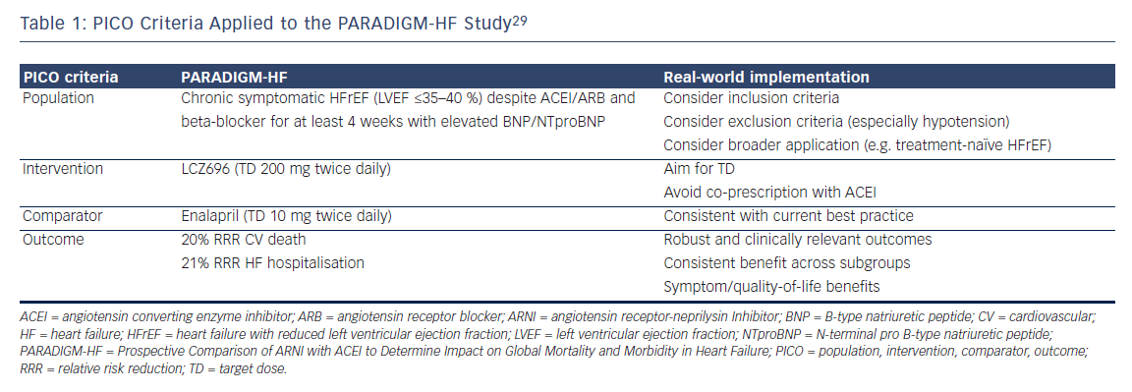
Hayman S, Atherton JJ
Table 1: PICO Criteria Applied to the PARADIGM-HF Study29
Citation: Cardiac Failure Review 2016;2(1):47–50
https://doi.org/10.15420/cfr.2016:2:2

