Slide 1
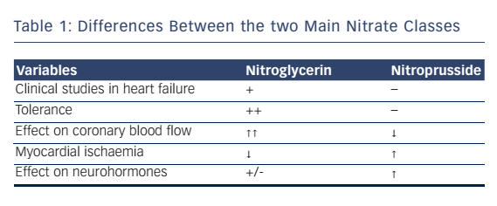
Alzahri MS, Rohra A, Peacock WF
Table 1: Differences Between the two Main Nitrate Classes
Citation: Cardiac Failure Review 2016;2(1):51–5
https://doi.org/10.15420/cfr.2016:3:3

