Slide 1
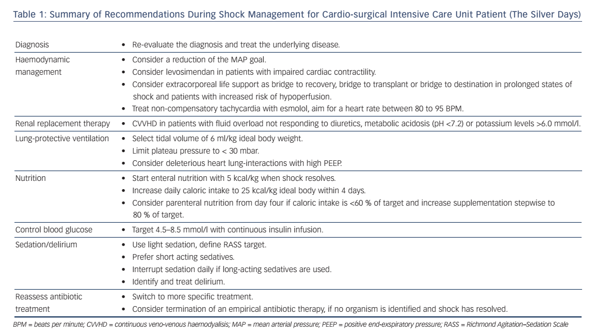
Hauffe T, Krüger B, Bettex D, Rudiger A
Table 1: Summary of Recommendations During Shock Management for Cardio-surgical Intensive Care Unit Patient (The Silver Days)
Citation: Cardiac Failure Review 2016;2(1):56–62
https://doi.org/10.15420/cfr.2015:27:2

