Slide 1

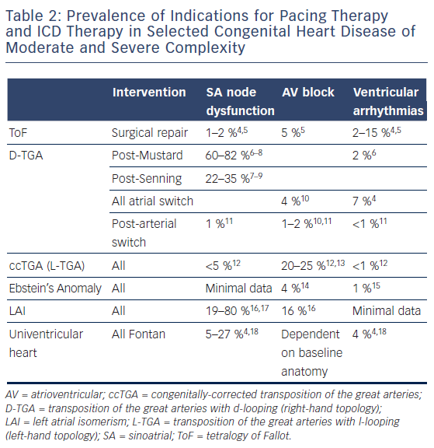
Chubb H, O’Neill M, Rosenthal E
Pacing and Defibrillators in Complex Congenital Heart Disease
Citation: Arrhythmia & Electrophysiology Review 2016;5(1):57–64
https://doi.org/10.15420/aer.2016.2.3

