Slide 1
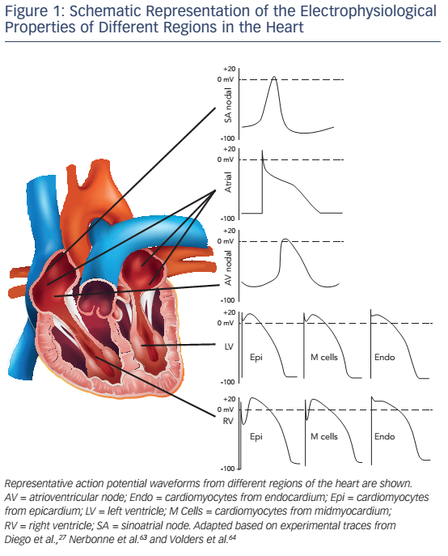
Molina CE, Heijman J, Dobrev D
Figure 1: Schematic Representation of the Electrophysiological Properties of Different Regions in the Heart
Citation: Arrhythmia & Electrophysiology Review 2016;5(1):14–9
https://doi.org/10.15420/aer.2016.8.2

