Slide 1
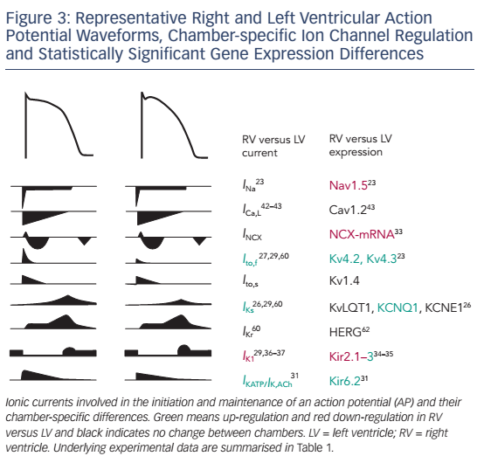
Molina CE, Heijman J, Dobrev D
Figure 3: Representative Right and Left Ventricular Action Potential Waveforms, Chamber-specific Ion Channel Regulation and Statistically Significant Gene Expression Differences
Citation: Arrhythmia & Electrophysiology Review 2016;5(1):14–9
https://doi.org/10.15420/aer.2016.8.2

