Slide 1
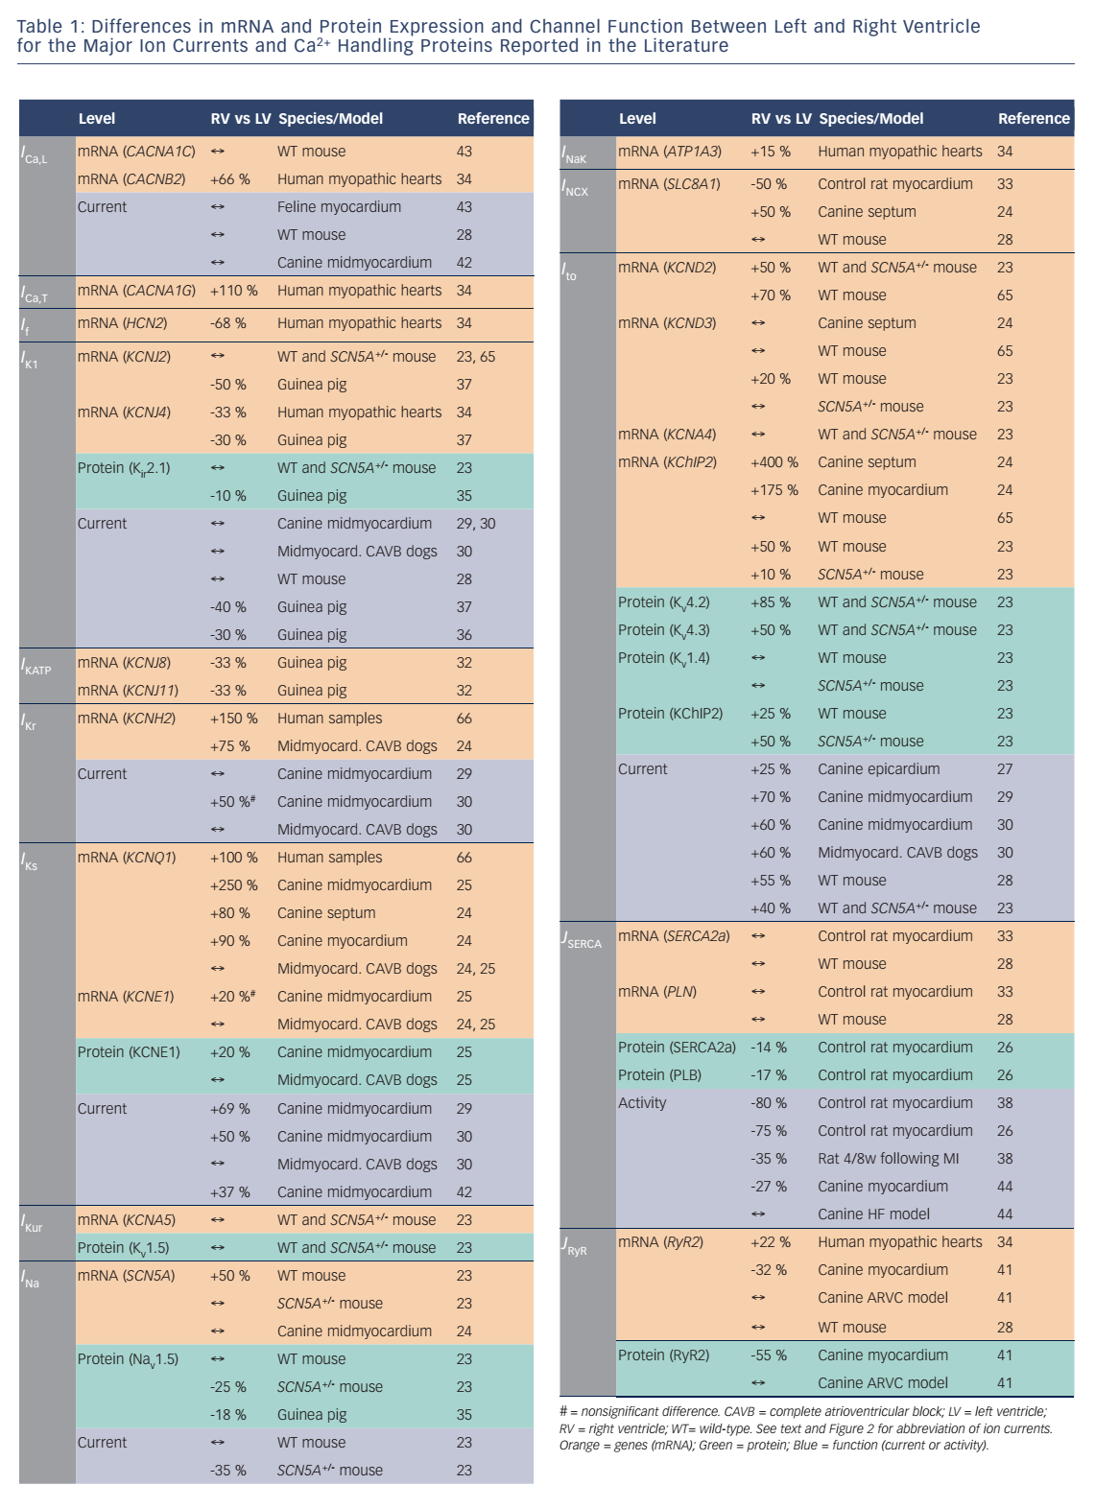
Molina CE, Heijman J, Dobrev D
Table 1: Differences in mRNA and Protein Expression and Channel Function Between Left and Right Ventricle for the Major Ion Currents and Ca 2+ Handling Proteins Reported in the Literature
Citation: Arrhythmia & Electrophysiology Review 2016;5(1):14–9
https://doi.org/10.15420/aer.2016.8.2

