Slide 1
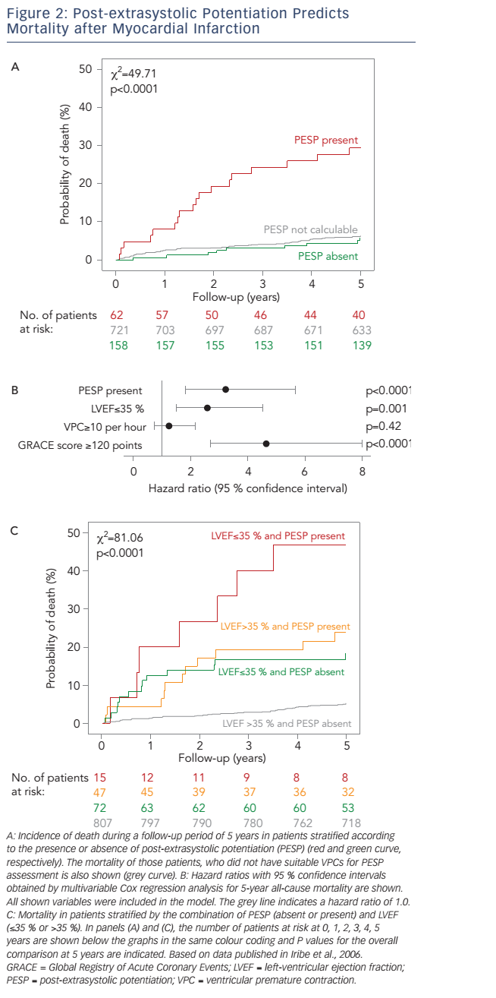
Steger A, Sinnecker D, Barthel P, Müller A, Gebhardt J, Schmidt G
Figure 2: Post-extrasystolic Potentiation Predicts Mortality after Myocardial Infarction
Citation: Arrhythmia & Electrophysiology Review 2016;5(1):27–30
https://doi.org/10.15420/aer.2016.14.2

