Slide 1
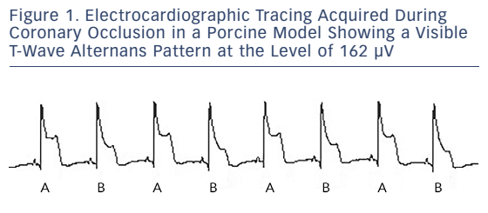
Aro AL, Kenttä TV, Huikuri HV
Figure 1. Electrocardiographic Tracing Acquired During Coronary Occlusion in a Porcine Model Showing a Visible T-Wave Alternans Pattern at the Level of 162 µV
Citation: Arrhythmia & Electrophysiology Review 2015;5(1):37–40
https://doi.org/10.15420/aer.2015.28.1

