Slide 1
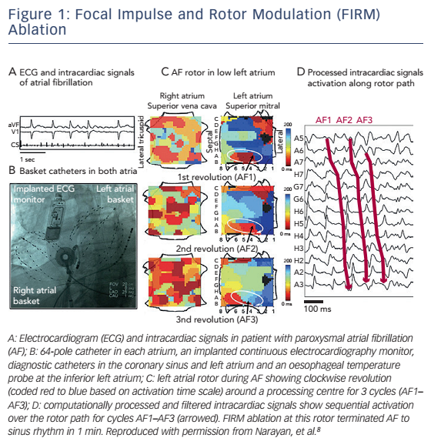
Siontis KC, Oral H
Figure 1: Focal Impulse and Rotor Modulation (FIRM) Ablation
Citation: Arrhythmia & Electrophysiology Review 2016;5(1):50–6
https://doi.org/10.15420/aer.2015.23.3

