Slide 1
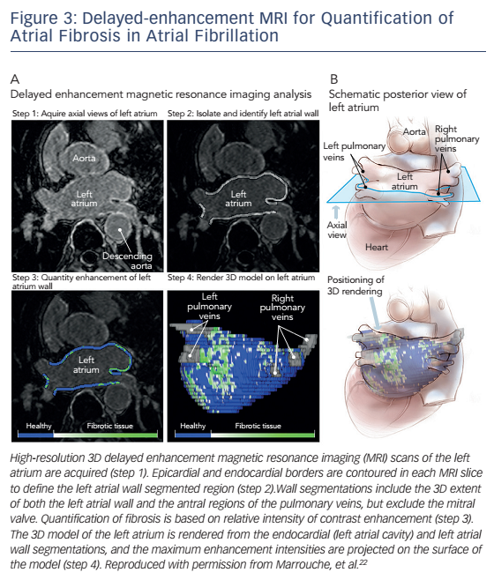
Siontis KC, Oral H
Figure 3: Delayed-enhancement MRI for Quantification of Atrial Fibrosis in Atrial Fibrillation
Citation: Arrhythmia & Electrophysiology Review 2016;5(1):50–6
https://doi.org/10.15420/aer.2015.23.3

