Slide 1
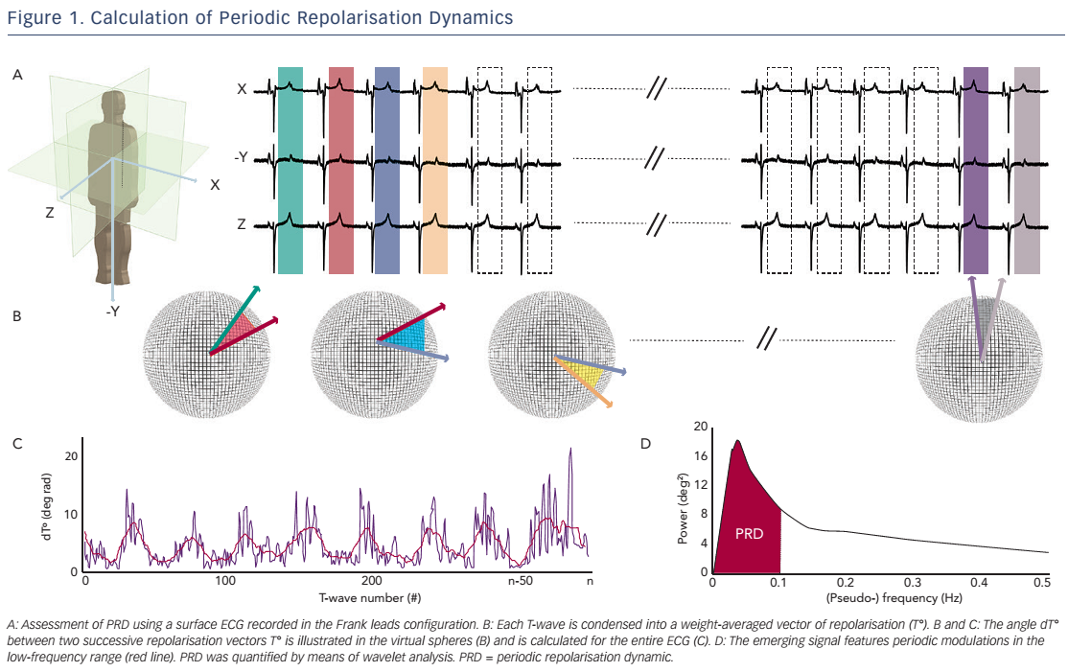
Rizas KD, Hamm W, Kääb S, Schmidt G, Bauer A
Figure 1. Calculation of Periodic Repolarisation Dynamics
Citation: Arrhythmia & Electrophysiology Review 2016;5(1):31–6
https://doi.org/10.15420/aer.2015:30:2

