Slide 1
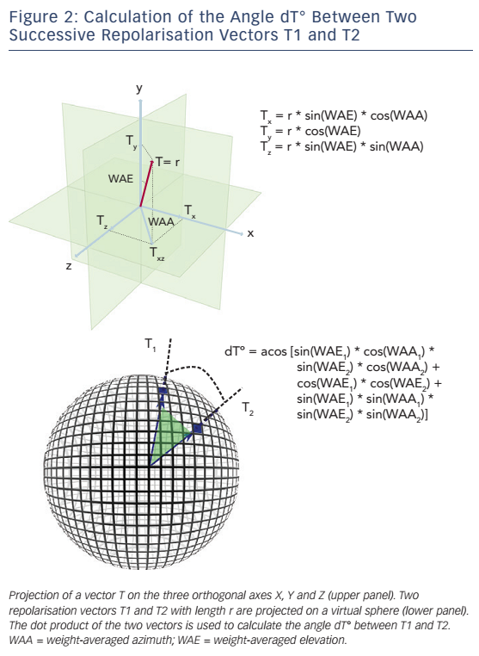
Rizas KD, Hamm W, Kääb S, Schmidt G, Bauer A
Figure 2: Calculation of the Angle dT° Between Two Successive Repolarisation Vectors T1 and T2
Citation: Arrhythmia & Electrophysiology Review 2016;5(1):31–6
https://doi.org/10.15420/aer.2015:30:2

