Slide 1
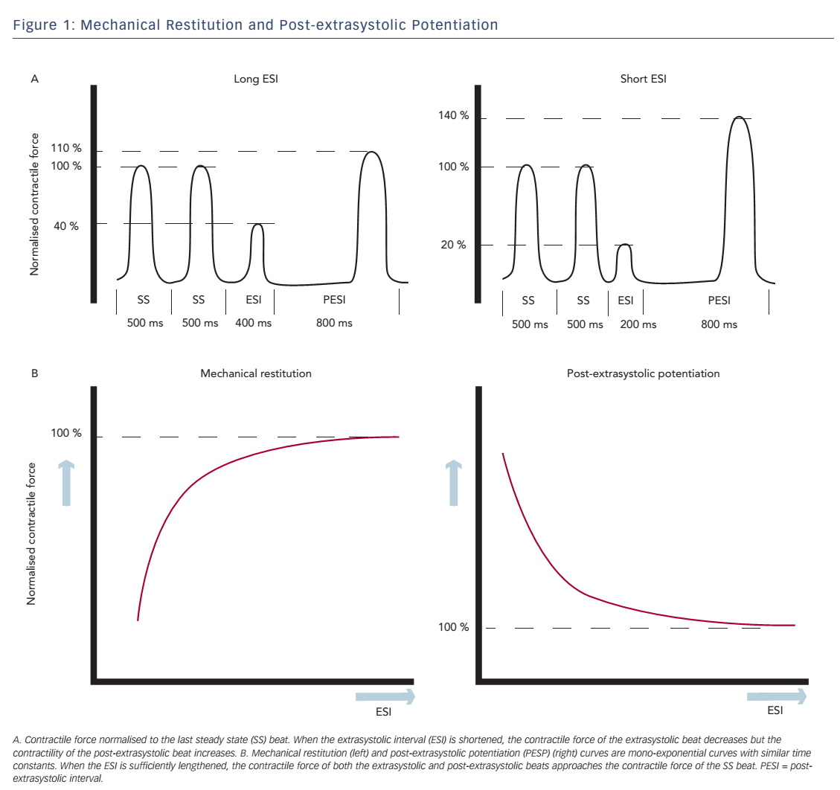
Sprenkeler DJ, Vos MA
Figure 1: Mechanical Restitution and Post-extrasystolic Potentiation
Citation: Arrhythmia & Electrophysiology Review 2016;5(1):20–6
https://doi.org/10.15420/aer.2015.29.2

