Slide 1
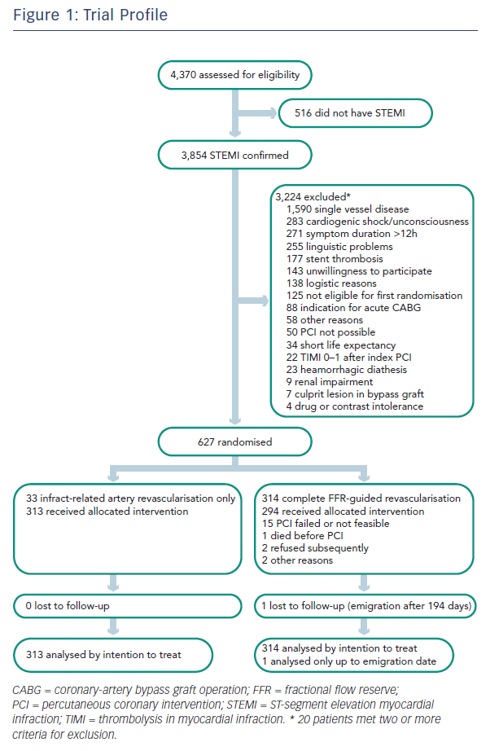
Engstrøm T
Figure 1: Trial Profile
Citation: RadcliffeCardiology.com, June 2016

