Slide 1
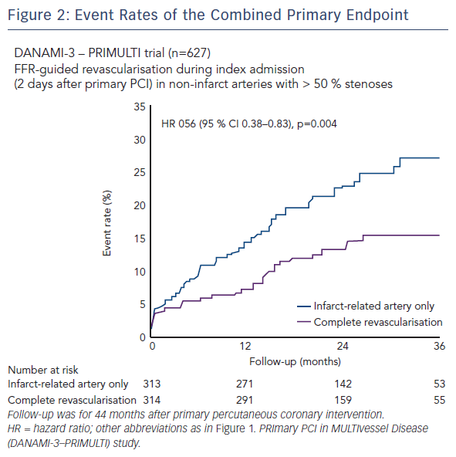
Engstrøm T
Figure 2: Event Rates of the Combined Primary Endpoint
Citation: RadcliffeCardiology.com, June 2016

