Slide 1
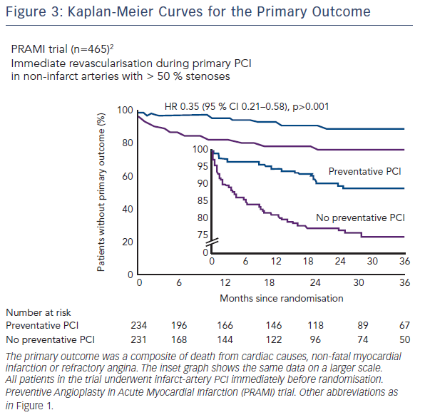
Engstrøm T
Figure 3: Kaplan-Meier Curves for the Primary Outcome
Citation: RadcliffeCardiology.com, June 2016

