Slide 1
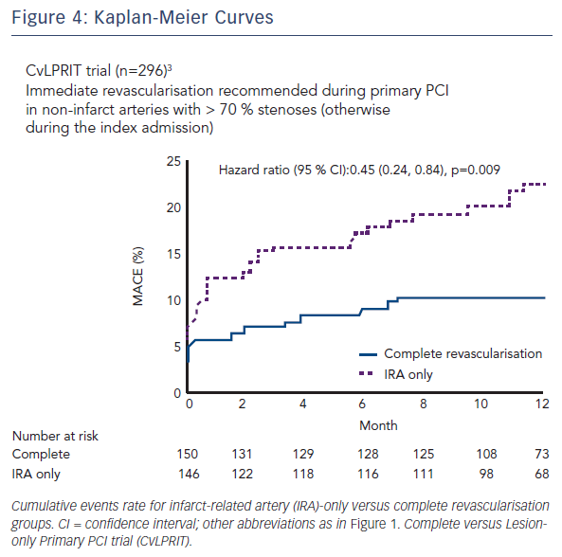
Engstrøm T
Figure 4: Kaplan-Meier Curves
Citation: RadcliffeCardiology.com, June 2016

