Slide 1
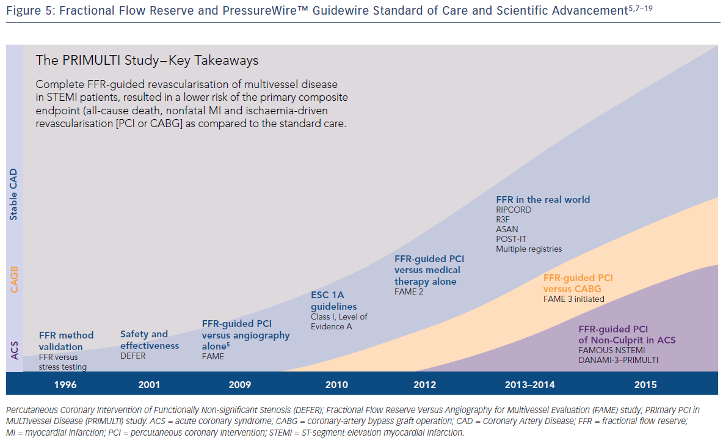
Engstrøm T
Figure 5: Fractional Flow Reserve and PressureWire™ Guidewire Standard of Care and Scientific Advancement
Citation: RadcliffeCardiology.com, June 2016

