Slide 1
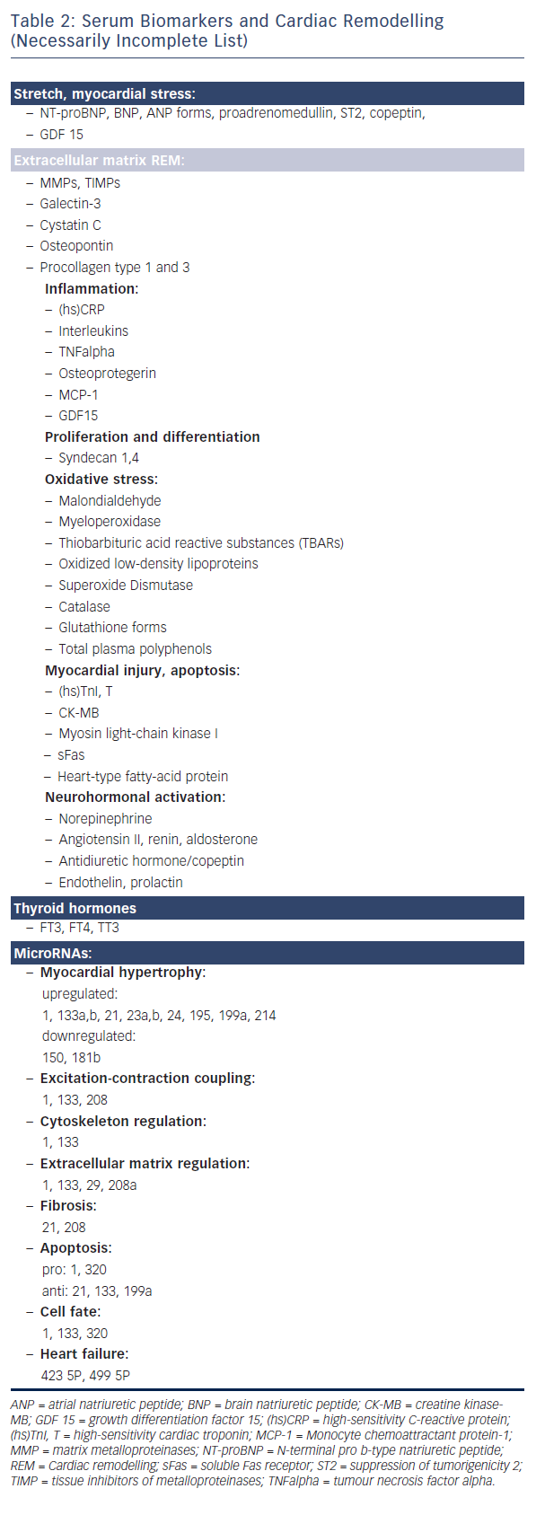
Cokkinos DV, Belogianneas C
Table 2: Serum Biomarkers and Cardiac Remodelling
Citation: European Cardiology Review 2016;11(1):29–35
https://doi.org/10.15420/ecr.2015:9:3

