Slide 1

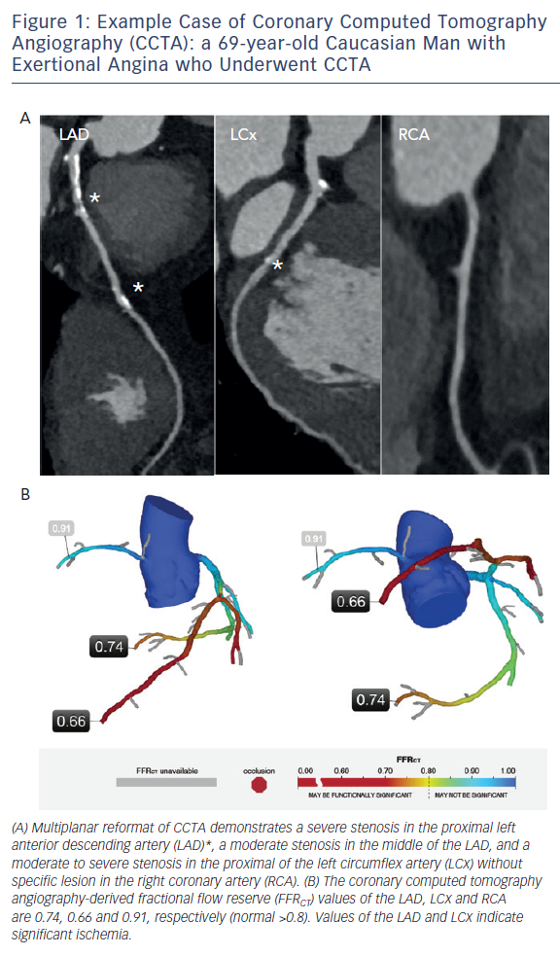
Lee JH, Hartaigh B�, Han D, Rizvi A, Lin FY, Min JK
Figure 1: Example Case of Coronary Computed Tomography Angiography (CCTA): a 69-year-old Caucasian Man with Exertional Angina who Underwent CCTA
Citation: Interventional Cardiology Review 2016;11(2):105–9
https://doi.org/10.15420/icr.2016:1:2

