Slide 1

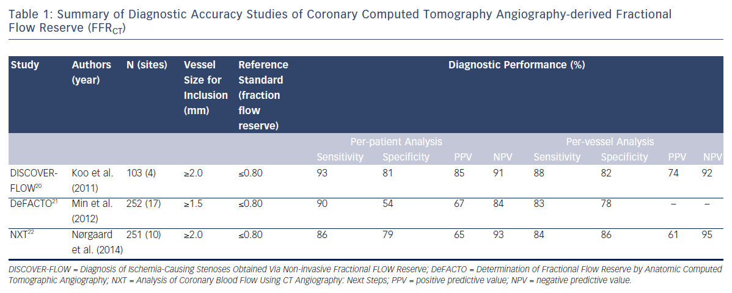
Lee JH, Hartaigh B�, Han D, Rizvi A, Lin FY, Min JK
Table 1: Summary of Diagnostic Accuracy Studies of Coronary Computed Tomography Angiography-derived Fractional Flow Reserve (FFRCT)
Citation: Interventional Cardiology Review 2016;11(2):105–9
https://doi.org/10.15420/icr.2016:1:2

