Slide 1
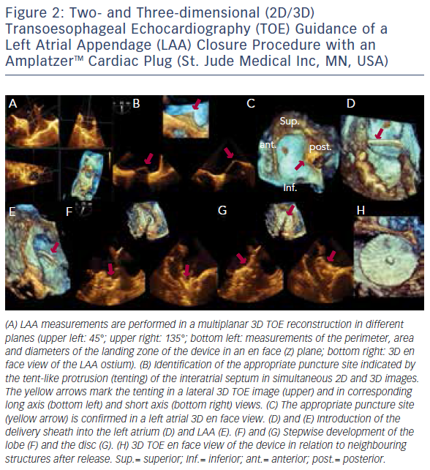
Wunderlich NC, Küx H, Kreidel F, Birkemeyer R, Siegel RJ
Figure 2: Two- and Three-dimensional (2D/3D) Transoesophageal Echocardiography (TOE) Guidance of a Left Atrial Appendage (LAA) Closure Procedure with an AmplatzerTM Cardiac Plug (St. Jude Medical Inc, MN, USA)
Citation: Interventional Cardiology Review 2016;11(2):135–9
https://doi.org/10.15420/icr.2016:12:2

