Slide 1
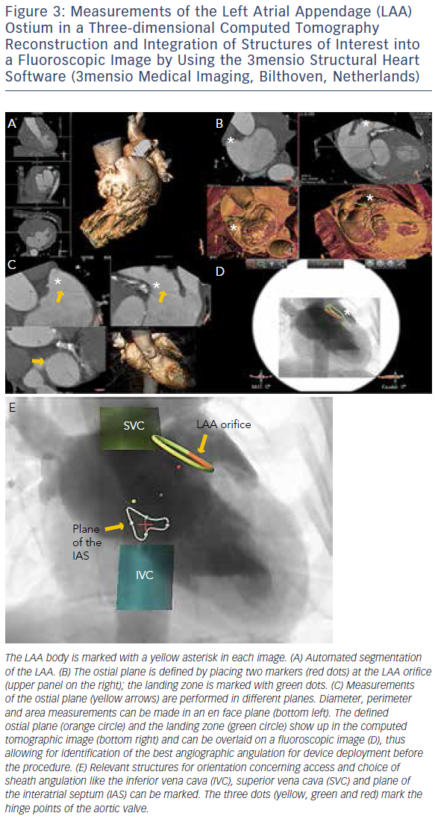
Wunderlich NC, Küx H, Kreidel F, Birkemeyer R, Siegel RJ
Figure 3: Measurements of the Left Atrial Appendage (LAA) Ostium in a Three-dimensional Computed Tomography Reconstruction and Integration of Structures of Interest into a Fluoroscopic Image by Using the 3mensio Structural Heart Software
Citation: Interventional Cardiology Review 2016;11(2):135–9
https://doi.org/10.15420/icr.2016:12:2

