Slide 1
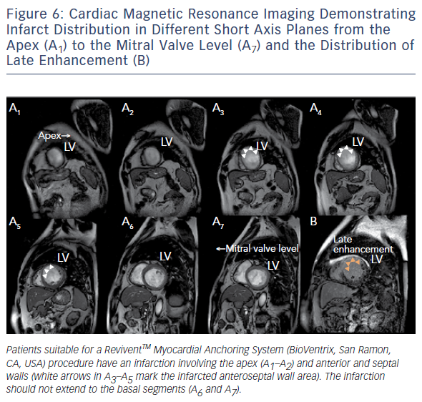
Wunderlich NC, Küx H, Kreidel F, Birkemeyer R, Siegel RJ
Figure 6: Cardiac Magnetic Resonance Imaging Demonstrating
Citation: Interventional Cardiology Review 2016;11(2):135–9
https://doi.org/10.15420/icr.2016:12:2

