Slide 1
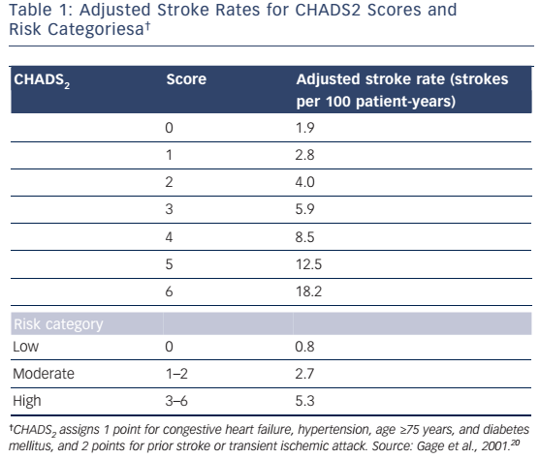
Fohtung RB, Rich MW
Table 1: Adjusted Stroke Rates for CHADS2 Scores and Risk Categoriesa
Citation: US Cardiology Review 2016;10(2):60–4
https://doi.org/10.15420/usc.2016:1:1

