Slide 1
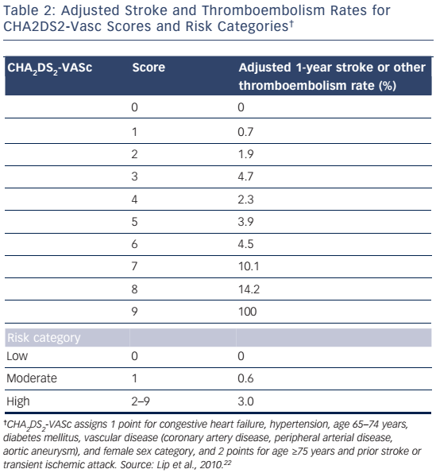
Fohtung RB, Rich MW
Table 2: Adjusted Stroke and Thromboembolism Rates for CHA2DS2-Vasc Scores and Risk Categories
Citation: US Cardiology Review 2016;10(2):60–4
https://doi.org/10.15420/usc.2016:1:1

