Slide 1
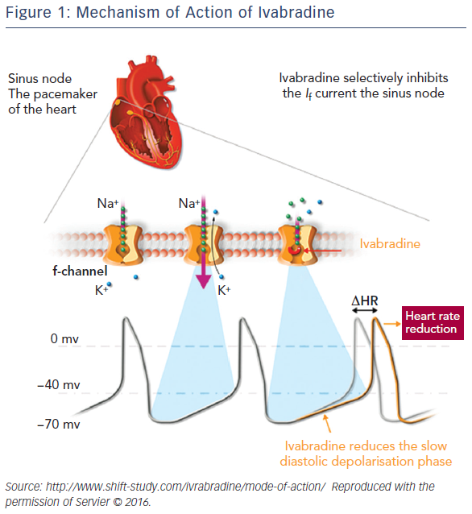
Volterrani M, Iellamo F
Figure 1: Mechanism of Action of Ivabradine
Citation: Cardiac Failure Review 2016;2(2)130–6
https://doi.org/10.15420/cfr.2016:12:1

