Slide 1
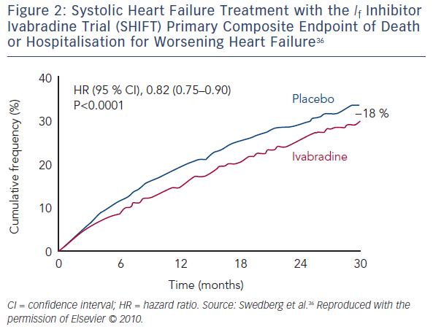
Volterrani M, Iellamo F
Figure 2: Systolic Heart Failure Treatment with the If Inhibitor Ivabradine Trial (SHIFT) Primary Composite Endpoint of Death or Hospitalisation for Worsening Heart Failure
Citation: Cardiac Failure Review 2016;2(2)130–6
https://doi.org/10.15420/cfr.2016:12:1

