Slide 1
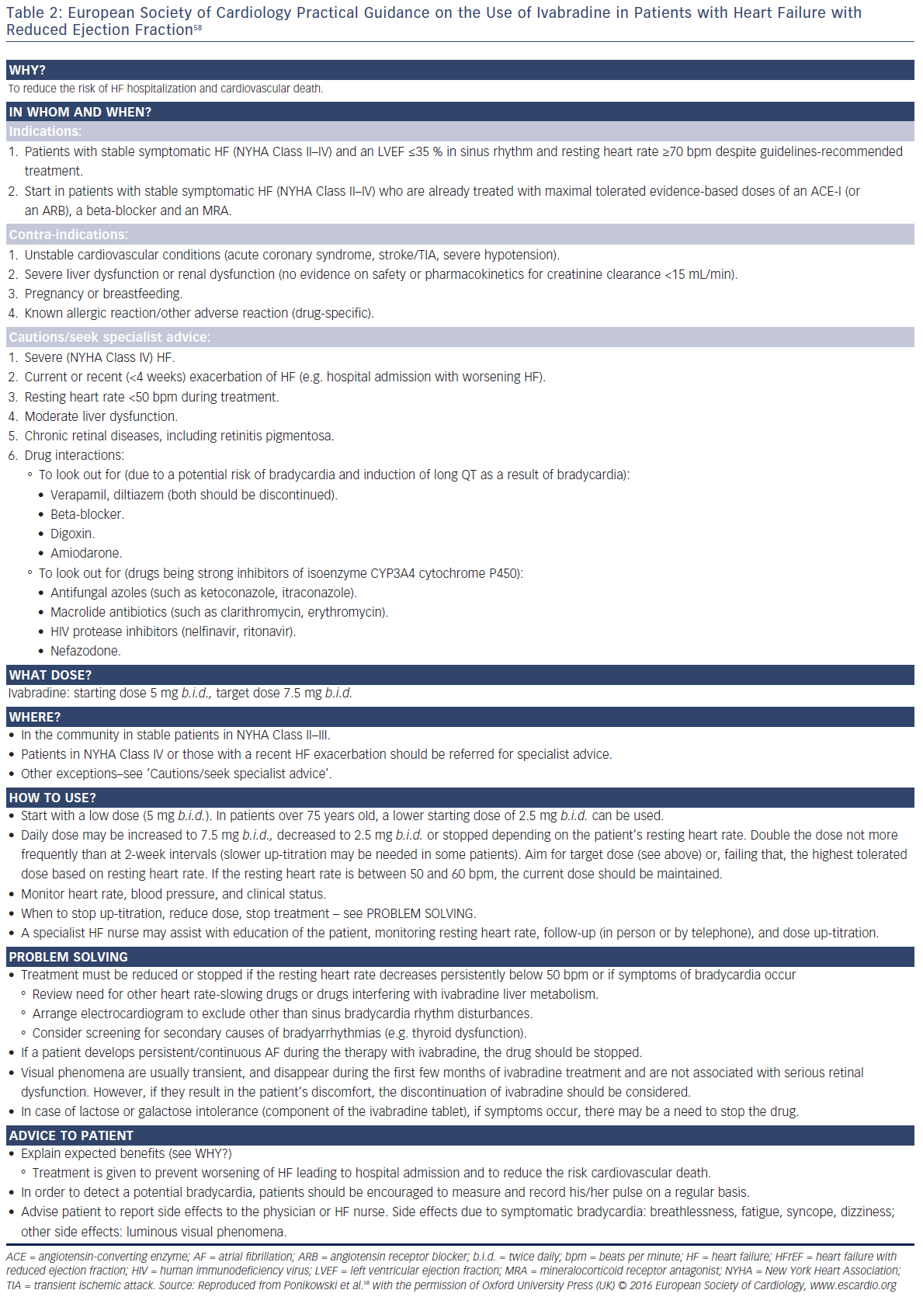
Volterrani M, Iellamo F
Table 2: European Society of Cardiology Practical Guidance on the Use of Ivabradine in Patients with Heart Failure with&lt;br /&gt;&#10;Reduced Ejection Fraction
Citation: Cardiac Failure Review 2016;2(2)130–6
https://doi.org/10.15420/cfr.2016:12:1

