Slide 1
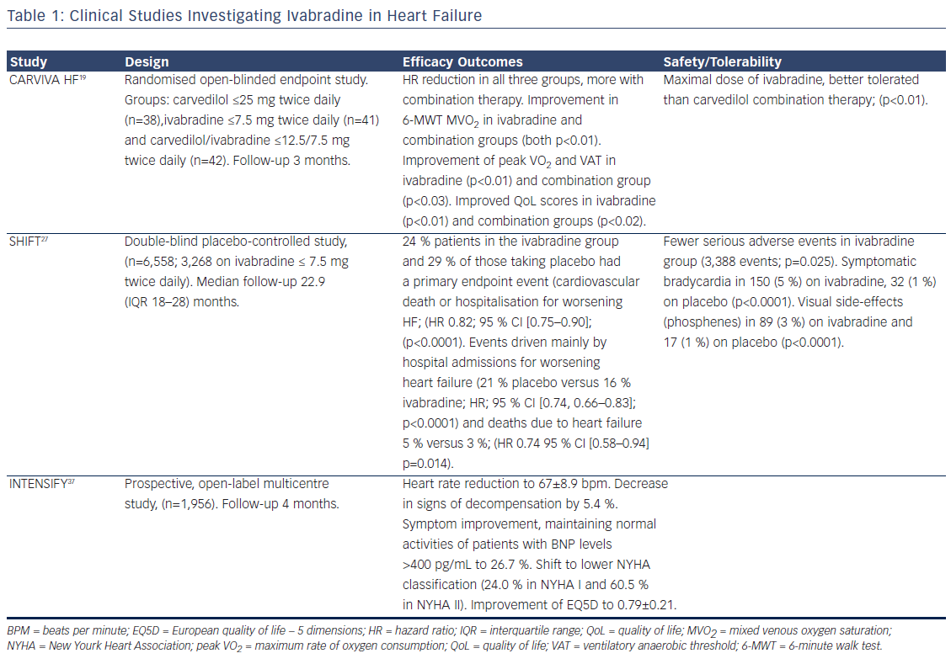
Milinkovic I, Rosano G, Lopatin Y, Seferovic PM
Table 1: Clinical Studies Investigating Ivabradine in Heart Failure
Citation: Cardiac Failure Review, 2016;2(2):123–9
https://doi.org/10.15420/cfr.2016:13:1

