Slide 1
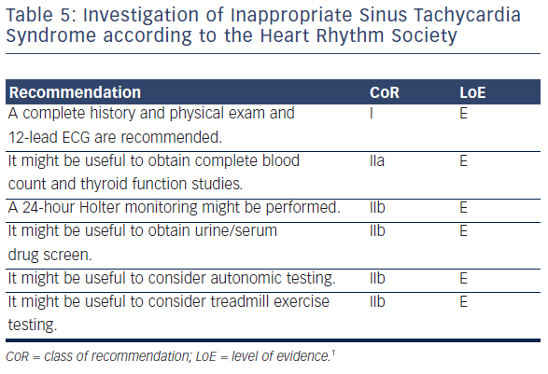
Raj S, Sheldon R
Table 5: Investigation of Inappropriate Sinus Tachycardia Syndrome according to the Heart Rhythm Society
Citation: Arrhythmia & Electrophysiology Review 2016;5(2):122–9
https://doi.org/10.15420/aer.2016.7.2

