Slide 1
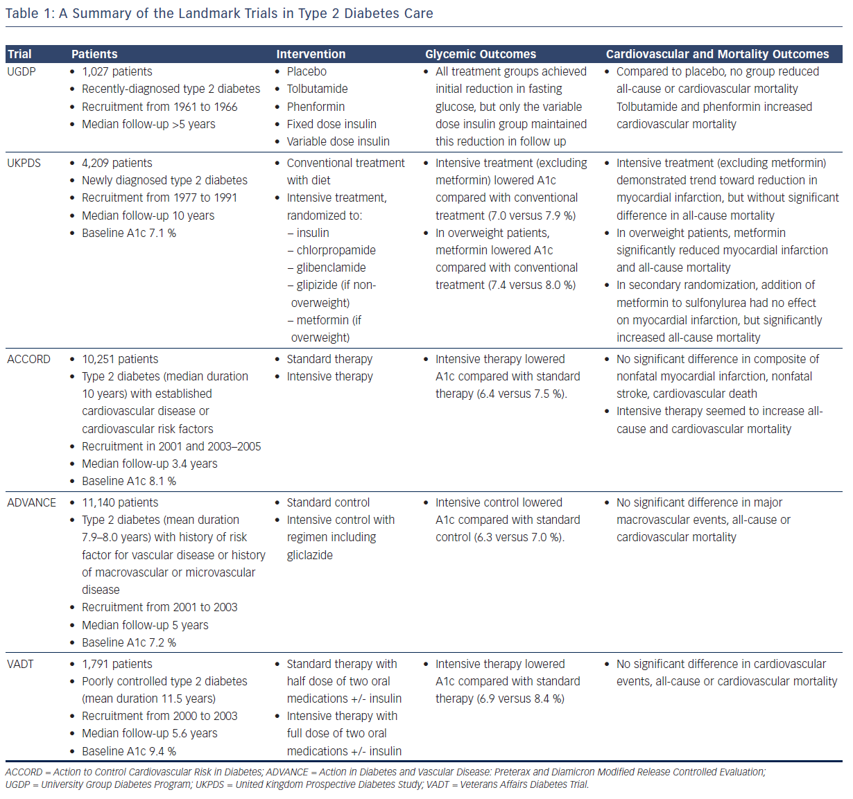
Ku S, Edelman SV
Table 1: A Summary of the Landmark Trials in Type 2 Diabetes Care
Citation: US Cardiology Review 2016;10(2):54–9
https://doi.org/10.15420/usc.2016:4:2

