Slide 1
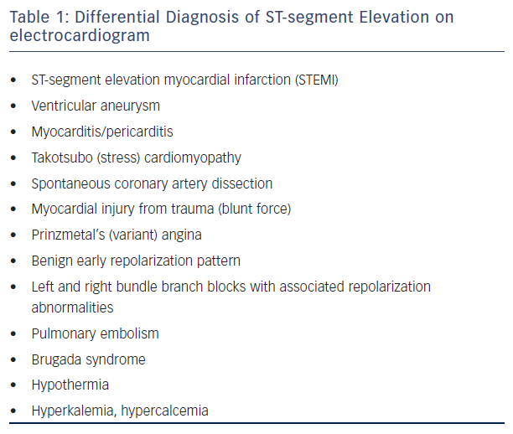
Riley RF, McCabe JM
Table 1: Differential Diagnosis of ST-segment Elevation on electrocardiogram. St Elevation Differential Diagnosis.
Citation: US Cardiology Review 2016;10(2):91–4
https://doi.org/10.15420/usc.2016:5:2

