Slide 1

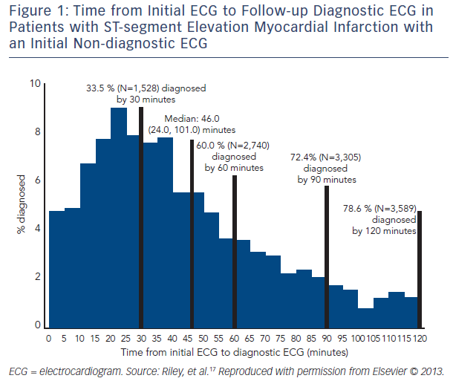
Riley RF, McCabe JM
Figure 1: Time from Initial ECG to Follow-up Diagnostic ECG in Patients with ST-segment Elevation Myocardial Infarction with an Initial Non-diagnostic ECG
Citation: US Cardiology Review 2016;10(2):91–4
https://doi.org/10.15420/usc.2016:5:2

