Slide 1
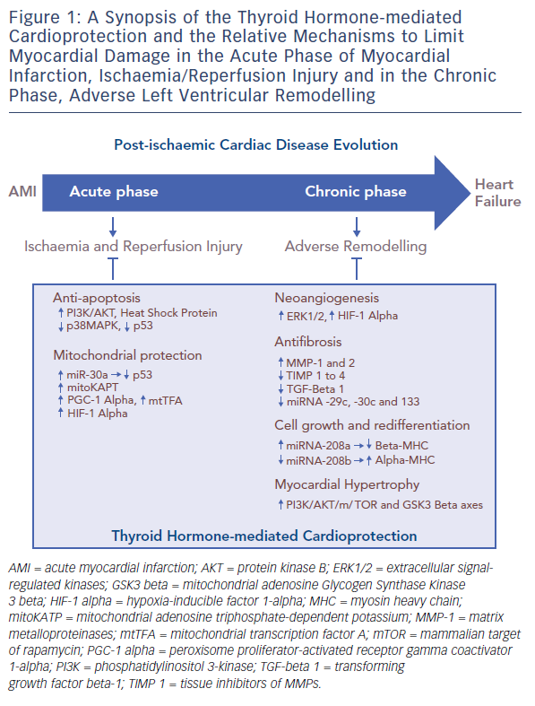
Pingitore A, Iervasi G, Forini F
Figure 1: A Synopsis of the Thyroid Hormone-mediated Cardioprotection
Citation: European Cardiology Review 2016;11(1):36–42
https://doi.org/10.15420/ecr.2016:9:2

