Slide 1
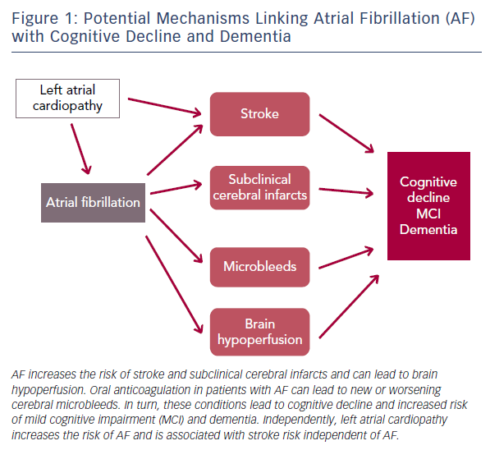
Alonso A, Arenas de Larriva AP
Figure 1: Potential Mechanisms Linking Atrial Fibrillation (AF) with Cognitive Decline and Dementia
Citation: European Cardiology Review 2016;11(1):49–53
https://doi.org/10.15420/ecr.2016:13:2

