Slide 1
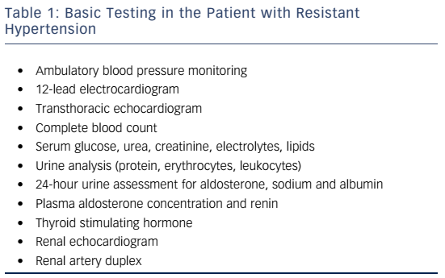
Tsioufis CP, Kasiakogias A, Tousoulis D
Table 1: Basic Testing in the Patient with Resistant Hypertension
Citation: European Cardiology Review 2016;11(1):12–7
https://doi.org/10.15420/ecr.2016:1:2

