Slide 1
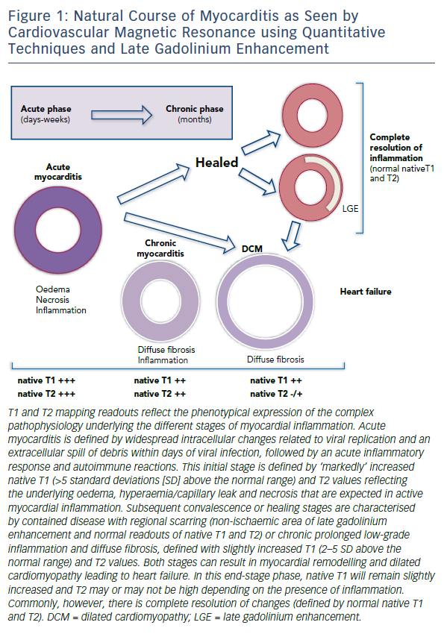
Hinojar R, Nagel E, Puntmann VO
Figure 1: Natural Course Of Myocarditis As Seen By Cardiovascular Magnetic Resonance Using Quantitative Techniques And Late Gadolinium Enhancement
Citation: European Cardiology Review 2016;11(1):20–4
https://doi.org/10.15420/ecr.2016:18:2

