Slide 1
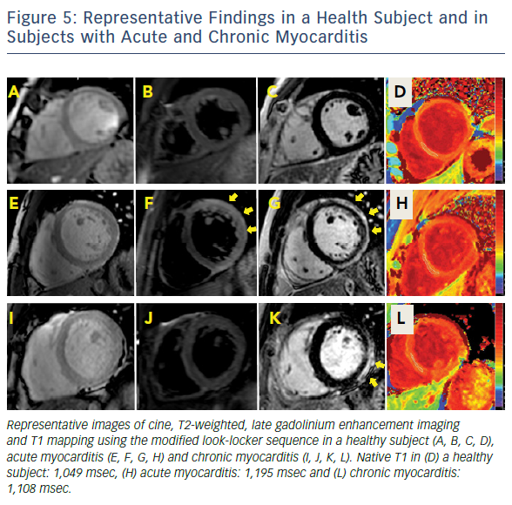
Hinojar R, Nagel E, Puntmann VO
Figure 5: Representative Findings In A Health Subject And In Subjects With Acute And Chronic Myocarditis
Citation: European Cardiology Review 2016;11(1):20–4
https://doi.org/10.15420/ecr.2016:18:2

