Slide 1
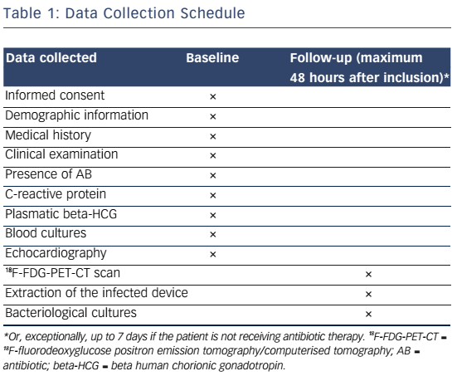
Amraoui S, Tlili G, Hindié E, Perez P, Peuchant O, Bordenave L, Bordachar P
Table 1: Data Collection Schedule
Citation: European Cardiology Review 2016;11(1):25–8
https://doi.org/10.15420/ecr.2016:6:2

