Slide 1
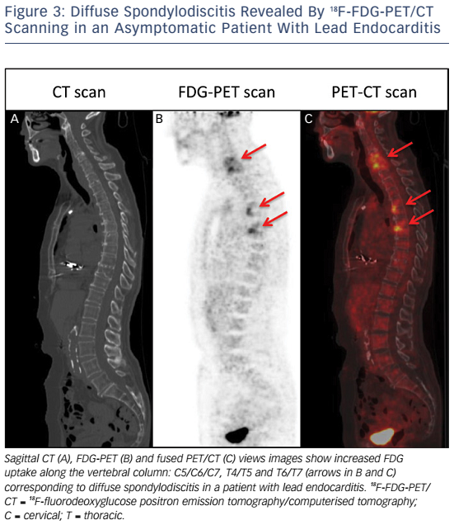
Amraoui S, Tlili G, Hindié E, Perez P, Peuchant O, Bordenave L, Bordachar P
Figure 3: Diffuse Spondylodiscitis Revealed By 18F-FDG-PET/CT Scanning in an Asymptomatic Patient With Lead Endocarditis
Citation: European Cardiology Review 2016;11(1):25–8
https://doi.org/10.15420/ecr.2016:6:2

