Slide 1
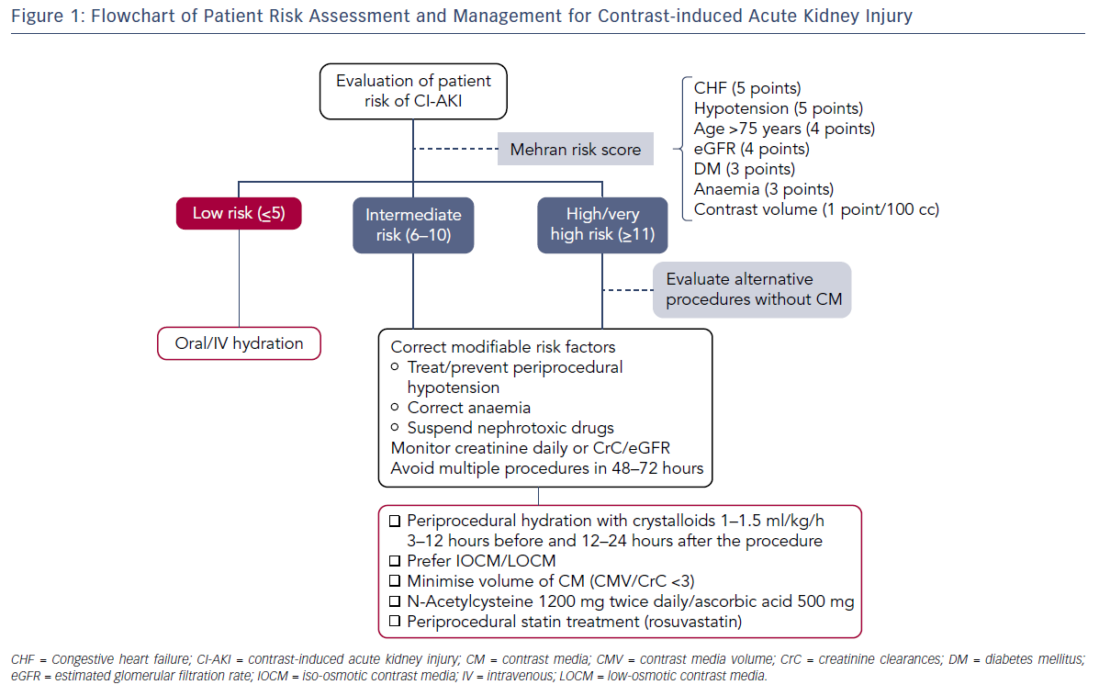
Faggioni M, Mehran R
Figure 1: Flowchart of Patient Risk Assessment and Management for Contrast-induced Acute Kidney Injury
Citation: Interventional Cardiology Review 2016;11(2):98–104
https://doi.org/10.15420/icr.2016:10:2

