Slide 1
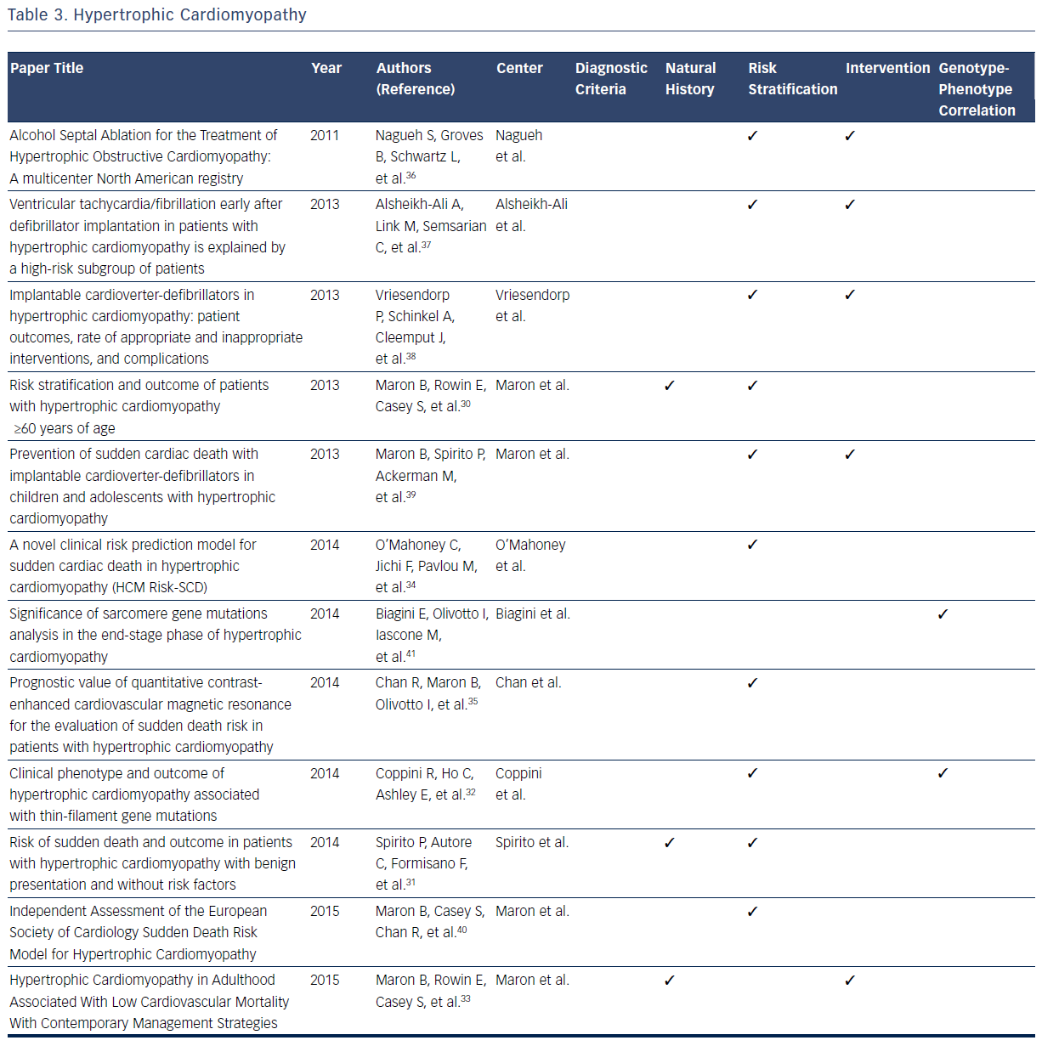
Hermel M, Duffy R, Orfanos A, Hack I, McEnteggart S, Shapero K, Batra S, Estes III NM
Table 3. Hypertrophic Cardiomyopathy
Citation: US Cardiology Review 2016;10(2):65–74
https://doi.org/10.15420/usc.2016:3:2

