Slide 1
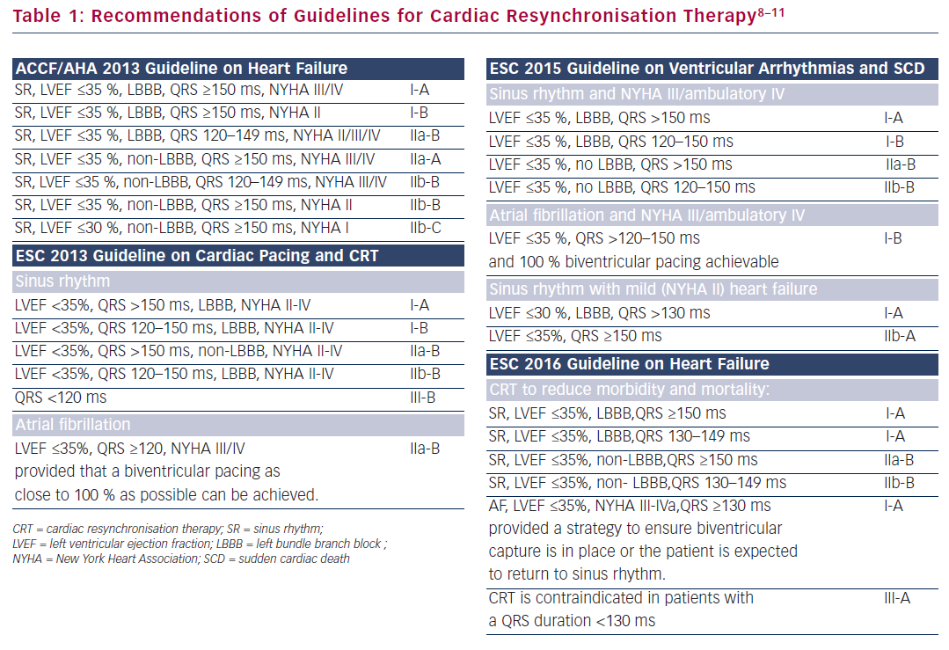
Katritsis DG
Table 1: Recommendations Of Guidelines For Cardiac Resynchronisation Therapy
Citation: Arrhythmia & Electrophysiology Review 2016;5(2):80-1
https://doi.org/10.15420/aer.2016.5.2.80

