Slide 1
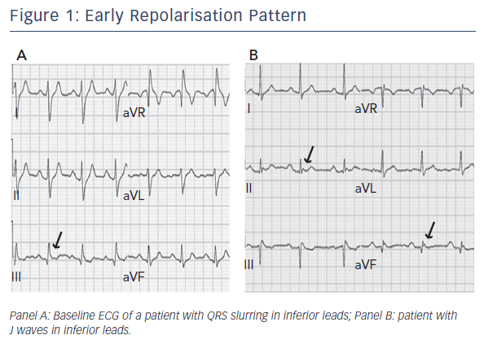
Conte G, Luce Caputo M, Regoli F, Moccetti T, Brugada P, Auricchio A
Figure 1: Early Repolarisation Pattern
Citation: Arrhythmia & Electrophysiology Review2016;5(2):84–9
https://doi.org/10.15420/aer.2016.23.2

