Slide 1
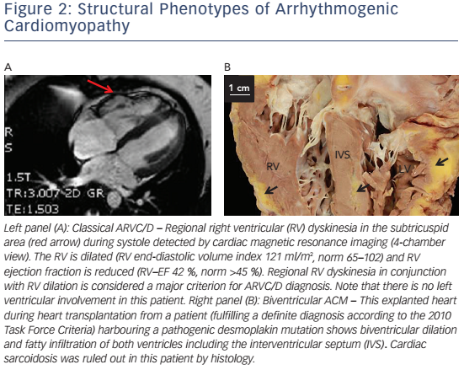
Akdis D, Brunckhorst C, Duru F, Saguner AM
Figure 2: Structural Phenotypes of Arrhythmogenic Cardiomyopathy
Citation: Arrhythmia & Electrophysiology Review 2016;5(2):90–101
https://doi.org/10.15420/aer.2016.4.3

