Slide 1
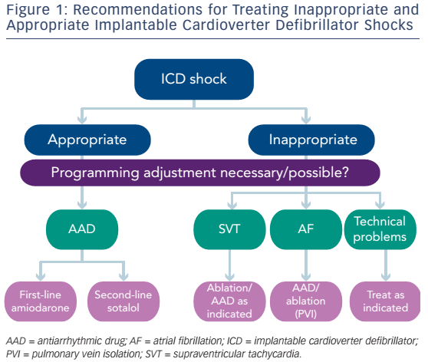
Abboud J, Ehrlich JR
Figure 1: Recommendations For Treating Inappropriate And Appropriate Implantable Cardioverter Defibrillator Shocks
Citation: Arrhythmia & Electrophysiology Review 2016;5(2):117–21
https://doi.org/10.15420/aer.2016.10.2

