Slide 1
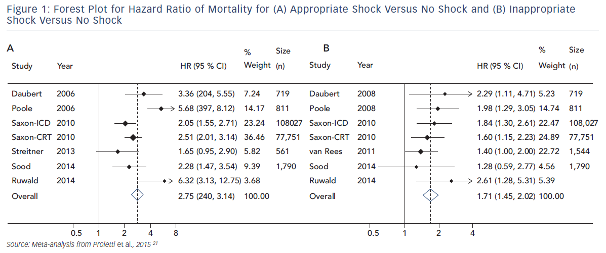
Li AC, Kaura A, Sunderland N, Dhillon PS, Scott PA
Figure 1: Forest Plot For Hazard Ratio Of Mortality For (A) Appropriate Shock Versus No Shock And (B) Inappropriate Shock Versus No Shock
Citation: Arrhythmia & Electrophysiology Review 2016;5(2):110–6
https://doi.org/10.15420/aer.2016.12.2

